Slide 1
Matrix unit - 1 semester – 1

Slide 2
agenda
Introduction- what is matrix
Matrix Definition
Matrix used in real life
11 types of matrix
Number system
Sets

Slide 3

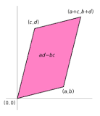
What is matrix Definition. A matrix is a rectangular array of numbers (or other mathematical objects), called the entries of the matrix. Matrices are subject to standard operations such as addition and multiplication. Most commonly, a matrix over a field F is a rectangular array of elements of F.

Slide 4
Matrix definition
Matrices also have important applications in computer graphics, where they have been used to represent rotations and other transformations of images.
Historically, it was not the matrix but a certain number associated with a square array of numbers called the determinant that was first recognized. Only gradually did the idea of the matrix as an algebraic entity emerge. The term matrix was introduced by the 19th-century English mathematician James Sylvester, but it was his friend the mathematician Arthur Cayley who developed the algebraic aspect of matrices in two papers in the 1850s. Cayley first applied them to the study of systems of linear equations, where they are still very useful. They are also important because, as Cayley recognized, certain sets of matrices form algebraic systems in which many of the ordinary laws of arithmetic (e.g., the associative and distributive laws) are valid but in which other laws (e.g., the commutative law) are not valid.
If there are m rows and n columns, the matrix is said to be an “m by n” matrix, written “m × n.” For example,
Matrix.
is a 2 × 3 matrix. A matrix with n rows and n columns is called a square matrix of order n. An ordinary number can be regarded as a 1 × 1 matrix; thus, 3 can be thought of as the matrix [3]. A matrix with only one row and n columns is called a row vector, and a matrix with only one column and n rows is called a column vector.
In a common notation, a capital letter denotes a matrix, and the corresponding small letter with a double subscript describes an element of the matrix. Thus, aij is the element in the ith row and jth column of the matrix A. If A is the 2 × 3 matrix shown above, then a11 = 1, a12 = 3, a13 = 8, a21 = 2, a22 = −4, and a23 = 5. Under certain conditions, matrices can be added and multiplied as individual entities, giving rise to important mathematical systems known as matrix algebras.
Matrices occur naturally in systems of simultaneous equations. In the following system for the unknowns x and y,
Equations.
the array of numbers

Slide 5

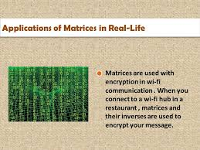
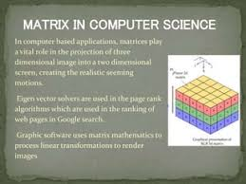
Matrix used in real life
Enhancing your presentation A matrix is a rectangular array of numbers arranged in rows and columns. Matrices can be used in many fields to model and solve real-world problems. Here are some examples of how matrices are used in real life:
Health care: Matrix multiplication can be used to develop scans.
Communication: Matrix multiplication can be used to encrypt messages and facilitate electronic communication.
Statistics: Matrices can be used to perform statistics, represent real-world statistics, and create graphs.
Economics: Matrices can be used to study business trends, create business models, and solve challenges like maximizing the use of assets.
Geology: Matrices can be used to conduct seismic surveys and scientific studies.
Physics: Matrices can be used to model electrical circuits, quantum mechanics, and optics.
Computer applications: Matrices can be used for 3D image projection, page ranking algorithms, encryption, and computer graphics.
Gaming: Matrices can be used to alter objects in in-d space.

Slide 6
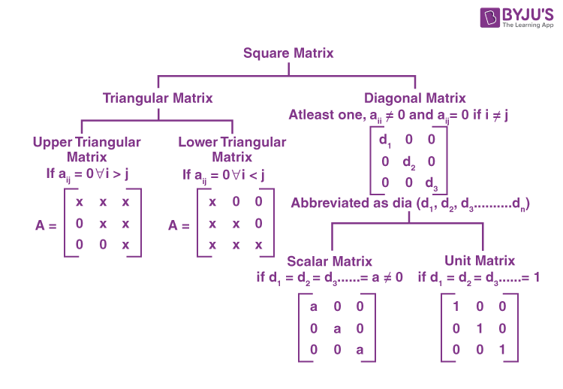
Diagonal matrix: A special square matrix where all entries that are not diagonal are zero, but the diagonal entries can be zero or non-zero.
Identity matrix: A square matrix with all elements as zero, except for the diagonal elements, which are non-zero. It is denoted by I.
Null matrix: A matrix with all elements as zero, and can be of any order. It is also a singular matrix, meaning it doesn't have an inverse and its determinant is zero.
Row matrix: A matrix with only one row, and the number of columns is irrelevant.
Square matrix: A matrix with elements a11, a22, …, ann, where i = j, and these elements are called the diagonal elements.
Upper triangular matrix: A matrix with all elements below the main diagonal as zero.
Lower triangular matrix: A matrix similar to an upper triangular matrix, but with all elements above the diagonal as zero.
Skew symmetric matrix: A matrix where all values of det A are equal to zero.

Slide 7
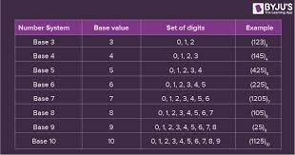
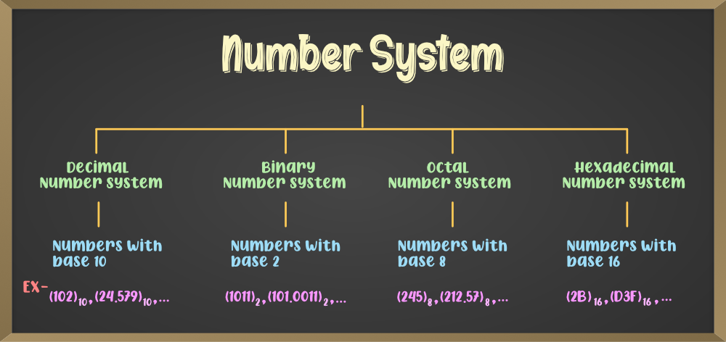
Number system
A number system is a mathematical notation that uses symbols or digits to represent numbers in a consistent way. Number systems allow us to uniquely represent numbers, perform arithmetic operations, and understand the algebraic and arithmetic structure of numbers.
The value of a digit in a number is determined by its position in the number, the digit itself, and the base of the number system. For example, in hexadecimal numbers, you can convert a decimal number into a hexadecimal number by dividing the decimal number by 16. The remainder becomes the least significant digit of the hexadecimal number, and you can use 0–9 for remainders 0–9 and A–F for remainders 10–15. You can then use the quotient as the new dividend and repeat the process until the quotient is 0, with the last remainder being the most significant digit.
There are many different types of number systems, including whole numbers, real numbers, and decimal number systems. The most common number system is the Hindu–Arabic numeral system, which uses 10 digits (0–9) and combinations of those digits to represent any number.

Slide 8
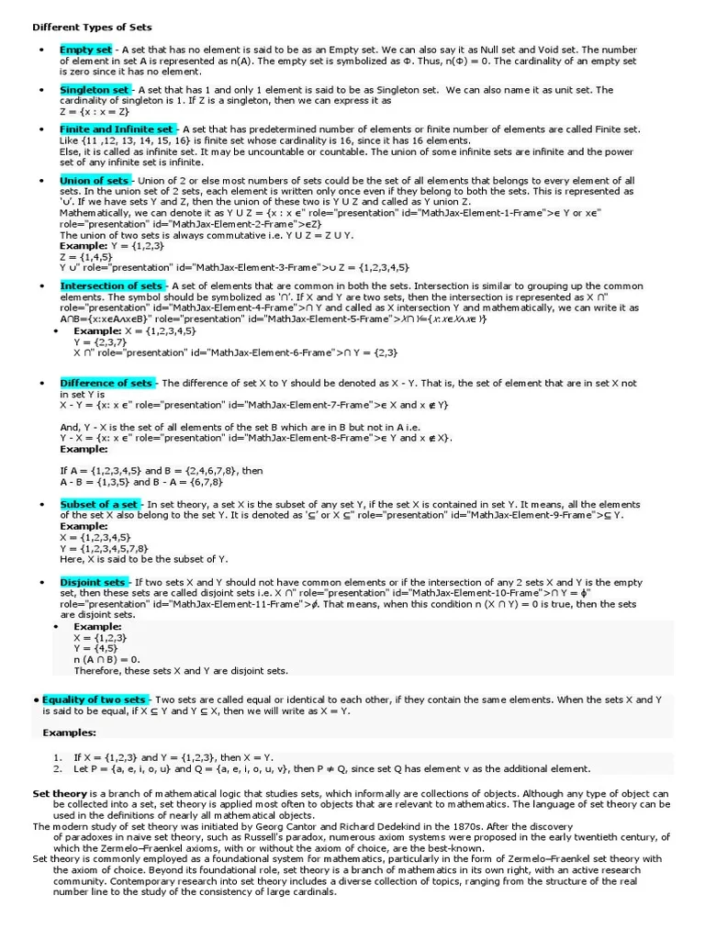
Sets
set is a collection of objects or elements that are well-defined. Sets can be represented in three forms: roster form, statement form, and set builder form.
Roster form
An example of a set in roster form is the set of even numbers less than 8, which is {2, 4, 6}.
Statement form
An example of a set in statement form is A = {Set of Odd numbers less than 9}.
Set builder form
An example of a set in set builder form is A = {x: x=2n, n ∈ N and 1 ≤ n ≤ 4}.
Here are some other types of sets:
Empty set
Also called a null set or void set, an empty set has no elements and is represented by {}. For example, if Set X = {x:x is the number of students studying in Class 6th and Class 7th}, then Set X is an empty set because a student cannot learn in two classes at the same time.
Equal set
Two sets are equal if they have the same elements. For example, A = {1,2,3} and B = {1,2,3} are equal sets, which can be represented as A = B.
Infinite set
An infinite set has an infinite number of elements. For example, A = {x : x is a natural number} is an infinite set because there are an infinite number of natural numbers.
Singleton set
A singleton set has only one element. For example, A = {0} is a singleton set.
Universal set
A universal set is a collection of all the elements in a particular subject and is represented by the letter "U". For example, if U is the set of all natural numbers, then the set of even numbers, odd numbers, and prime numbers are subsets of the universal set.

Slide 9
Thank-you
Can you solve this ?
If a hen and a half lay an egg and a half in a day and a half, how many eggs will half a dozen hens lay in half a dozen days ?
Name – Yash A Panchal
Course – B.Sc. cs it
Semester – 1 ( 2024-25)
Division – B
Temporary enrollment number - 061
Email – ypanchal376@gmail.com

